Slide 1


Statistic
Lecture 9
Dr. Nada Abdullah Rasheed
Assist prof. / Computer Science

Slide 2
Syllabus Content
Subject | Lec. No.
Making Inferences about Regression Equations and Coefficients | 3

Slide 3





Regression

Slide 4
Regression
6.9 Regression in SPSS
The following uses the GRE Therapy Data file. This data file is based on a hypothetical study examining the influences of a study-aid drug and types of tutoring on performance on the Graduate Record Examinations (GREs). To have SPSS perform regression, from the Analyze menu, select Regression, and then select Linear:

Slide 5
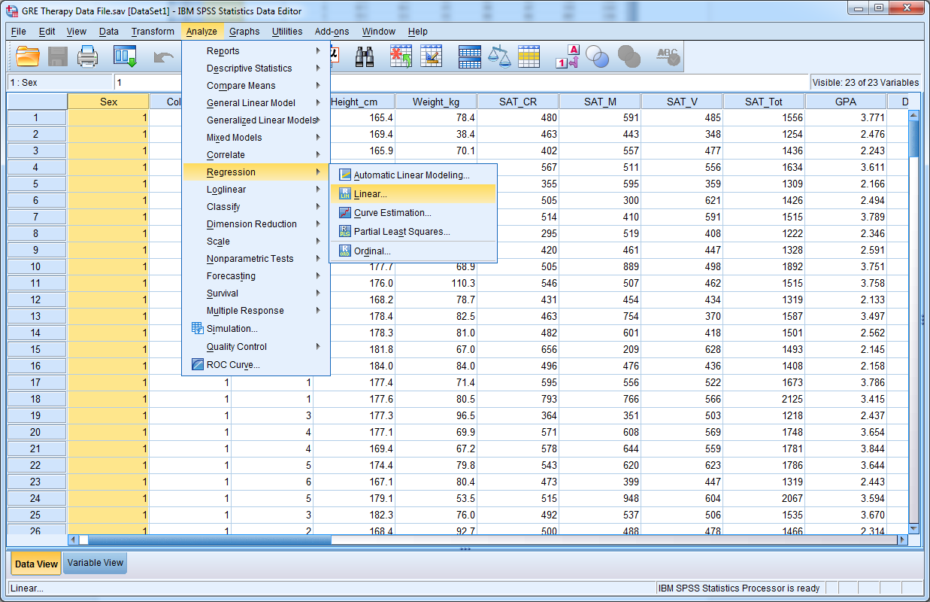
Regression

Slide 6
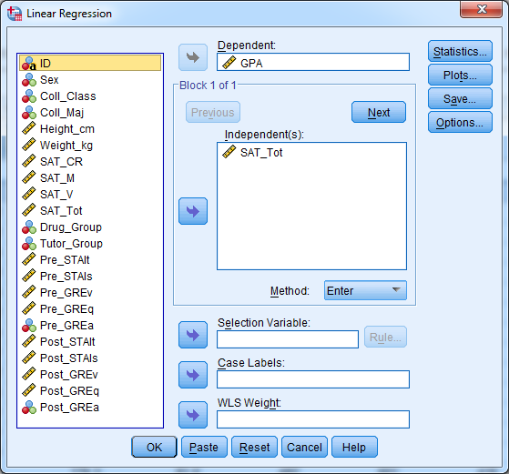
Regression
The SPSS output should resemble the output below. Description of the output follows the SPSS output.

Slide 7
Regression
Descriptive Statistics
 | Mean | Std. Deviation | N
GPA | 3.01082 | .670476 | 240
SAT_Tot | 1504.62 | 190.169 | 240

Slide 8
Regression
Correlations
 |  | GPA | SAT_Tot
Pearson Correlation | GPA | 1.000 | .774
 | SAT_Tot | .774 | 1.000
Sig. (1-tailed) | GPA | . | .000
 | SAT_Tot | .000 | .
N | GPA | 240 | 240
 | SAT_Tot | 240 | 240

Slide 9
Regression
Variables Entered/Removedª
Model | Variables Entered | Variables Removed | Method
1 | SAT_Tot^{b} | . | Enter
a. Dependent Variable: GPA
b. All requested variables entered.

Slide 10
Regression
Model Summary
Model | R | R Square | Adjusted R Square | Std. Error of the Estimate
1 | .774ª | .599 | .597 | .425693
a. Predictors: (Constant), SAT_Tot

Slide 11
Regression
ANOVAª
Model |  | Sum of Squares | Df | Mean Square | F | Sig.
1 | Regression | 64.311 | 1 | 64.311 | 354.887 | .000^{b}
 | Residual | 43.129 | 238 | .181
 | Total | 107.440 | 239
a. Dependent Variable: GPA
b. Predictors: (Constant), SAT_Tot

Slide 12
Regression
Coefficientsª
Model |  | Unstandardized Coefficients |  | Standardized Coefficients | t | Sig.
 |  | B | Std. Error | Beta
1 | (Constant) | -1.093 | .220 |  | -4.979 | .000
 | SAT_Tot | .003 | .000 | .774 | 18.838 | .000
a. Dependent Variable: GPA

